Slide 1
Majlis Ansarullah Monthly Meeting
Dec 2016
This slide deck contains images licensed for the purpose of this presentation only.
No one is permitted to use the images for any other use, without prior permission.

Slide 2
AGENDA
Recitation of the Holy Qur’an (3:32)
Pledge
Reminders: Recitation of Holy Qur’an and Congregational Prayers
Monthly topic: Are we honoring our relationship with the Promised Messiah (alaihissalam)?
Health topic: Men’s Health
National Reminders/Announcements
Local Reminders/Announcements
Dua

Slide 3
Why read the Holy Qur’an regularly?
THE HOLY Qur’an IS HAKAM and MUHAIMIN
The Holy Qur’an is so glorious that none other can excel in its glory. It is Hakam, the one whose judgment is ultimate; it is Muhaimin, a compendium of all guidance. Therein is found every argument which one may require. It is the book which has scattered the defeat the very core of enemy’s might. A Book which covers everything in depth and contains the news of what was and what is to be. Falsehood can attack it not from the front and nor from the rear. It is the very light of God Almighty.
(Roohani Khaza’in, Vol 16, Page 103)

Slide 4
Watching Our Congregational Salat!
Prayers with 2 Other Men are Better than One
The Prophet (saw) said: “The prayer of a man with another man is better than his praying alone, and the prayer of a man with two other men is better than his praying alone or with only one other man, and the more people there are, the more beloved it is to Allah.”
(Sunan al-Nasa’i and Sunan Abi Dawud )

Slide 5
Are we giving precedence to our relationship with the Promised Messiah (alaihissalam) over worldly affairs?

Slide 6
Click to listen the recitation
[3:32] Say, ’If you love Allah, follow me: then will Allah love you and forgive you your faults. And Allah is Most Forgiving, Merciful.’

Slide 7
According to this verse, loving Allah and following the Holy Prophet (may peace and blessings of Allah be on him) is necessary. Why do you think, it is important to show a relationship of love and obedience with the Promised Messiah (alaihissalam)?
Share your thoughts

Slide 8
Guidance from Hazrat Musleh Mau’ud (ra)
The Promised Messiah (alaihissalam) says,
’Now rush towards me because this is the time that he who runs toward me now is like the one who gets on board the ship right at the time of a storm. But if someone does not accept me, I see that he is throwing himself into a storm and has no means of saving himself. I am a true intercessor as a shadow and reflection of that exalted intercessor, who was not accepted by the ignorant people of that age and who was gravely insulted, that is Hadrat Muhammad, the Chosen one, may peace and blessings of Allah be upon him.
(Dafi’ul-Bala’. Ruhani Khaza’in, vol. 18, p. 233)

Slide 9
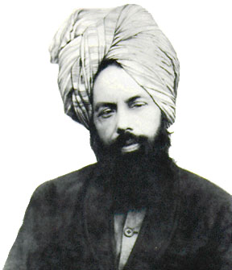
After coming back from the Promised Messiah Day celebration at the Mosque, your 15 years old son questions why it is important to show love and devotion to the Promised Messiah (alaihissalam) while so much misery, corruption and poverty is in the world today. He thinks our priority should be to help poor and needy instead of showing our love for the Promised Messiah. How do you respond to him?
Discussion I

Slide 10
Option 1: You should agree with him.
Option 2: You should strongly disagree with him and read to him the 10th condition of Bai’at.
Option 3: You should tell him that showing devotion to the Promised Messiah (alaihissalam) and trying to help poor and needy is the same thing.
Option 4: any other response

Slide 11
Guidance from the Promised Messiah
The Promised Messiah (alaihissalam) says, ’…Remember that God the Almighty likes good deeds very much, and He desires that sympathy be shown for His creation. If He desired harm, He would have directed us to be bad; but the Majesty of God is free from this. Therefore, all of you who have established a relationship with me should remember that you should show compassion for everyone regardless of their religion; and be good to all without any discrimination because this is the teaching of Holy Qur’an. Those captives and prisoners [at the time of the Prophet (sa)] were mostly non-believers. Now, you can see the scope of kindness in Islam. In my opinion, perfect moral teaching is not found anywhere except in Islam.’
(Malfuzat, new ed., vol. 4, pp. 218)

Slide 12
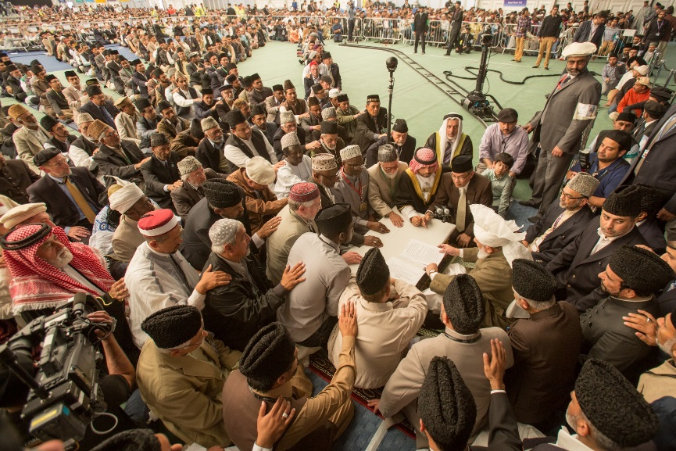
Discussion II
You have a friend who is under Tabligh. Once you share with him the Bai’at form. When he reads the 10th condition of Bai’at, he stumbles and questions why this is necessary. How do you respond?
10th condition of Bai’at: That he/she shall enter into a bond of brotherhood with this humble servant of God, pledging obedience to me in everything good for the sake of God, and remain faithful to it until the day of his/ her death. That he/she shall exert such a high devotion in the observance of this bond as is not to be found in any other worldly relationship and connection that demand devoted dutifulness.

Slide 13
Option 1: You tell him that this is necessary because the meaning of Bai’at is to accept the Promised Messiah (alaihissalam).
Option 2: You agree and tell him it is not very important, that is why it is the last condition.
Option 3: You tell him that it is not the condition put forward by the Promised Messiah but by the Holy Prophet (saw) himself.
Option 4: any other response.

Slide 14
Guidance from the Holy Prophet (saw)
Prophet Muhammad (saw) said, He who dies in a condition that he has not recognized the Imam of the age dies a death of ignorance.
Musnad Ahmad Bin Hanbal. Vol.4, Pg.96
Prophet Muhammad (saw) said, When you hear the advent of the Mahdi then enter into his fold even if you have to walk on snow by crawling and creeping to reach him.
Kanzul Ummal; also footnotes to Musnad Ahmad Bin Hanbal. Vol.6, p.29-30

Slide 15
During a dinner table discussion at the Mosque, Ansar are talking about the need of reading the books of Promised Messiah (alaihissalam). One Nasir said he hardly finds time to read the Holy Qur’an so he is unable to read Promised Messiah’s books. Another Nasir said its OK not to read the books, as long as he reveres Promised Messiah in his heart. Is this Nasir’s point of view correct?
Discussion III

Slide 16
Option 1: Yes, because obedience and devotion to Promised Messiah (alaihissalam) does not require reading of his books.
Option 2: No, because unless you know what Promised Messiah said, you can not show full obedience.
Option 3: Yes, because if you are able to read the Holy Qur’an, that should suffice as Promised Messiah only said what’s in the Qur’an.
Option 4: No, its important to read his books to understand the Holy Qur’an.

Slide 17
Guidance from Huzoor (aba)
The written works of the Promised Messiah (alaihissalam) are widely available on our web site and can be accessed whenever one wants. It is also translated in major languages of the world. It is important to understand the commentary and elucidations of the Promised Messiah of the Holy Qur’an and Sunnah. It is important to study these as they are widely available and no one has any excuse not to.
(Excerpt from Friday sermon, October 9, 2015)

Slide 18
A Short Video from Friday Sermon, Oct. 9, 2015

Slide 19
Translation of the Video
If a person truly recognizes and understands the religion, he will do the religious work with passion of love and sincerity. So Hazrat Masih Maud (alaihissalam) expects from us that after doing his Bai’at, we increase this passion. Unless this zeal of obedience and sincerity and this relationship is not there, his guidance will not have any effect. And there will be no effort to act upon his guidance. Hence if you want to follow his guidance, you have to follow his words, you will have to be sincere about your Bai’at and raise the standards of obedience, sincerity and allegiance. Can an Ahmadi even imagine that Hazrat Masih Maud may have said anything against the teachings of the Holy Qur’an and Sunnah? Certainly not! If so, then every Ahmadi needs to understand that Ma’roof obedience means complete obedience with the highest level of love and sincerity. Complete obedience is only possible if every order of the person who is being obeyed is pursued and sought after. So it is incumbent upon us to understand the expectations that the Promised Messiah has from us and the advices he has given us and try to act upon them. Otherwise it will only be a claim that we obey him in every matter. If we don’t even know his advices, then what is the meaning of obedience? What is being obeyed? So, when we become Ahmadi, it is a must that we increase our knowledge. This relationship that we have established in the way of Allah, we should expand this relationship to receive Allah’s acceptance and sincerely mold our lives accordingly.

Slide 20
Where do we stand?
اپنے جائزے لیں
Self-analyze yourself
During the last week, how many times did you ponder over any of the conditions of Bai’at?
How many days did you read a small portion of any of the books of Promised Messiah (alaihissalam)?
How many times did you read or listen to Dars of Malfuzat?
Add the three numbers together.
(Keep it to yourself… the “score” is for you!)

Slide 21
How to Improve?
اپنے اندر پاک تبدیلیاں پیدا کریں
Bring about pious changes in yourself
0-1
Combined Score
>7
Keep striving hard to strengthen your relationship with Promised Messiah and start reading his books.
Keep reading Promised Messiah’s books regularly and try putting that knowledge in practice
Continue to strengthen your relationship with the Promised Messiah and inspire your family as well

Slide 22
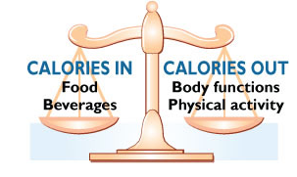
Health Topic: Men’s Health

Slide 23
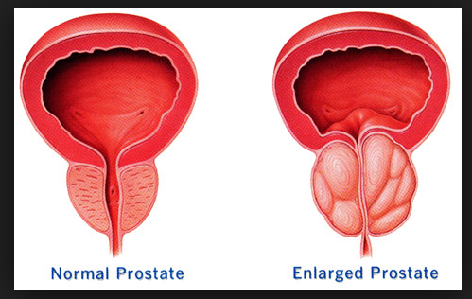
The Prostate
The prostate gland is about the size of a walnut. It is part of the male reproductive system and wraps around the tube that carries urine out of the bladder
It grows larger as you get older. If your prostate gets too large, it can cause health issues
Having prostate problems does not always mean you have cancer

Slide 24
The Prostate Problems
Benign prostatic hyperplasia (BPH) means that the prostate is enlarged but it is not a cancer. It is very common in older men
Prostate Cancer is common among American men. Risk Factors include Age. Men age 50 and older Race Most common among African-American men. Family history. Increased risk If your father or brother has had prostate cancer Diet Eating high-fat food with few fruits and vegetables may raise your risk
Watch for these symptoms and seek care with your doctor Frequent urge to urinate Need to get up many times during the night to urinate Blood in urine or semen Painful or burning urination Not being able to urinate Painful ejaculation Frequent pain or stiffness in lower back, hips, pelvic or rectal area, or upper thighs Dribbling of urine

Slide 25
How To Manage?
Treatment for prostate cancer depends on whether cancer is in part or all of the prostate or if it has spread to other parts of the body
It also depends on your age and overall health
Watchful Waiting or Active Surveillance. If the cancer is growing slowly and not causing problems, you may decide not to treat it right away
Surgery. There are different types of Surgical options
Radiation Therapy Talk to your doctor about possible side effects
Hormone Therapy can also be used for prostate cancer that has spread beyond the prostate (Metastatic Cancer)

Slide 26
National Reminders
Four Priorities for 2016
At least 50% of Tajnid to attend monthly meetings where we discuss our Khalifa’s vision: “Save yourself and your families from a fire” in interactive discussions.
Help establish a culture of congregational Salat.
Help strengthen the love of Holy Quran.
More than 50% Tajnid to attend National Ijtima. The National Ijtema and Shura will take place in BRM on Sep 23-25, 2016. Please start planning now

Slide 27
Local Reminders
Local Reminders
Dua

